Slide 1
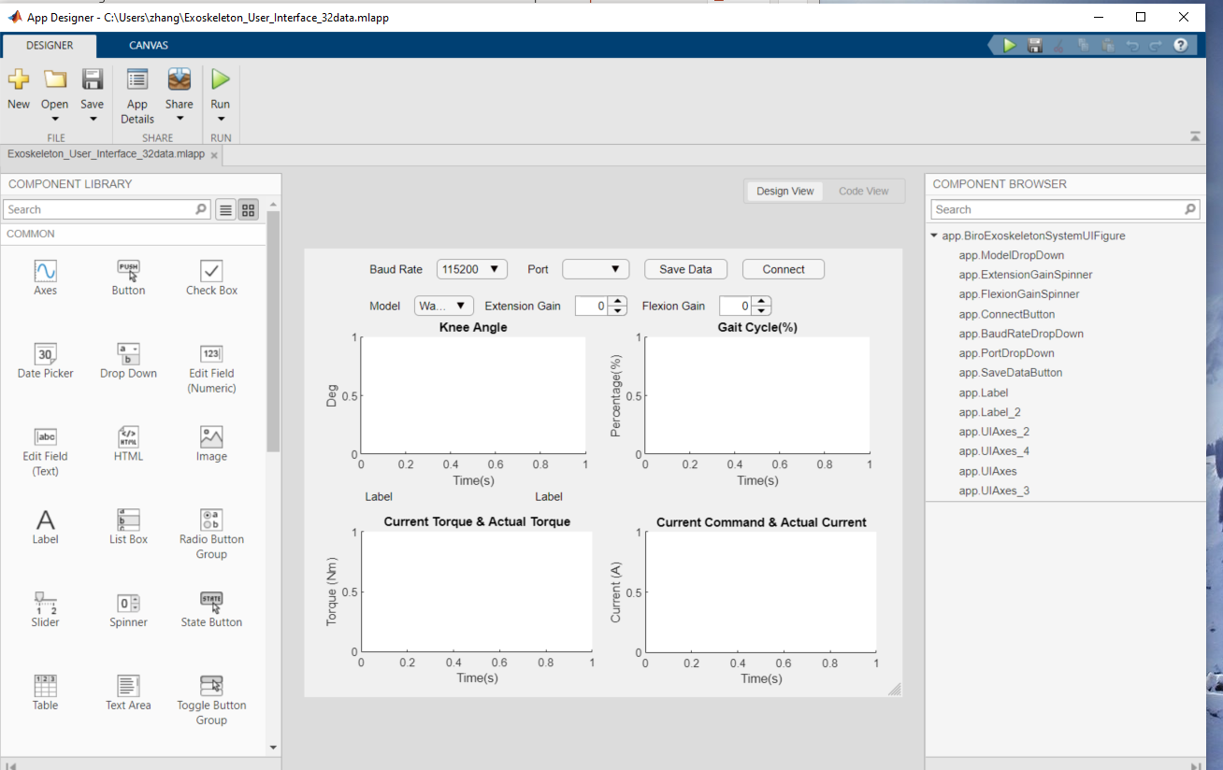
Exo-User Interface MATLAB App
Steps:
Install MATLAB R2019b, this APP is not compatible with other versions of MATLAB
Open MATLAB R2019b, open Exoskeleton_User_Interface_32data. Mlapp
Click ‘run’

Slide 2
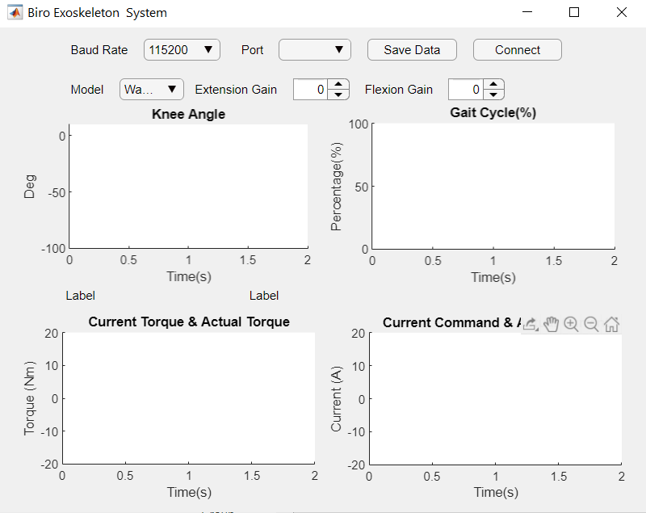
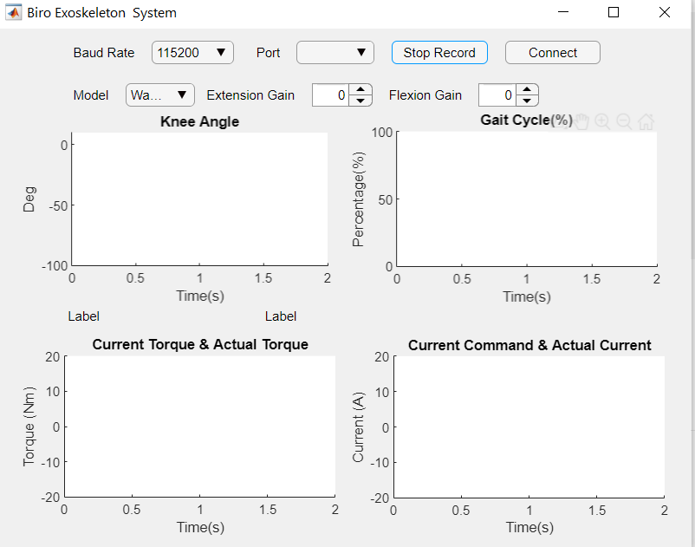
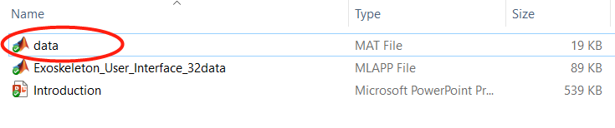
Exo-User Interface MATLAB App
Steps
Click ‘connect’ to connect two Bluetooth receivers. Bluetooth is responsible for incepting data, and sending some control commands
Save data: click ‘Save Data’ to begin save, click ‘Stop Save’， all data will be saved at ‘data.mat’. Notes: the ‘data.mat’ will only reserve the latest data.
Data will be saved at here

